Slide 1



Hidden Gems in SQL Server 2022
#sqlserver2022
#azuresql
Ajay Jagannathan, Principal Group PM Manager Dimitri Furman, Principal PM

Slide 2

The Hidden Gems
Hands-free tempdb
XML compression
Async stats update with low priority
Statistics auto-drop
T-SQL improvements
Purvi’s list

Slide 3
“Hands-free” tempdb
Tempdb lazy log flush
Tempdb != durability
1 file = PFS, GAM, SGAM contention
Add multiple files
Trace flags 1117 and 1118
SQL 2016 setup auto adds multiple files
Trace flags not required by SQL Server 2016
PFS concurrency
Autogrow and uniform default for tempdb
Now system table pages become hotspot
Tempdb metadata optimization ON
SGAM and GAM contention remain
SGAM and GAM concurrency
Latch contention gone
Pre SQL Server 2019
SQL Server 2019
SQL Server 2022

Slide 4

Demo
Hands-free tempdb

Slide 5
XML compression
XML data is stored in LOB allocation units
ROW and PAGE compression doesn’t compress LOB allocation units
ALTER INDEX ... REBUILD WITH (XML_COMPRESSION = ON);
Must use the xml data type
Can still use ROW or PAGE compression on the same index/partition
sp_estimate_data_compression_savings ... @xml_compression = 1

Slide 6

Demo
Use XML compression

Slide 7
Async statistics update with low priority
Statistics can be updated asynchronously AUTO_UPDATE_STATISTICS_ASYNC = ON
Enabled for consistent query latency in OLTP
Query compilation uses statistics object
Background stats update blocks new queries
It blocks background stats update

Slide 8
Before
After
ALTER DATABASE SCOPED CONFIGURATION SET ASYNC_STATS_UPDATE_WAIT_AT_LOW_PRIORITY = ON;

Slide 9

Demo
Solve Sch-M lock contention with a low priority queue

Slide 10
Statistics auto-drop
Statistics are schema objects
Schema changes can be blocked by dependencies
ALTER TABLE … ALTER COLUMN when column has statistics
Before SQL Server 2022
Automatic stats: auto-drop
User created stats: block schema change
Starting with SQL Server 2022
Automatic stats: auto-drop
User created stats: auto-drop if AUTO_DROP = ON

Slide 11

Demo
Unblock schema changes with statistics auto-drop

Slide 12
T-SQL improvements
IS [NOT] DISTINCT FROM
GENERATE_SERIES()
DATE_BUCKET()
DATETRUNC()
GREATEST() and LEAST()

Slide 13

Demo
Simplify T-SQL code with new functions

Slide 14

Purvi’s list
Reduce Buffer Pool I/O promotions
Enhanced core spinlock algorithms
Improved Virtual Log File (VLF) algorithms
Instant File Initialization (IFI) behavior for log file growth even with TDE enabled (does not require special privilege)

Slide 15

Demo
A better log autogrow

Slide 16
Other hidden gems
Cross-platform (T-SQL) SNAPSHOT backups
Accelerated Database Recovery (ADR) enhancements
Parallel Redo enhancements
Last valid restore time
SQLDumper enhancements
SHRINK and CREATE INDEX with WAIT_AT_LOW_PRIORITY
Query Store hints
New extended events

Slide 17

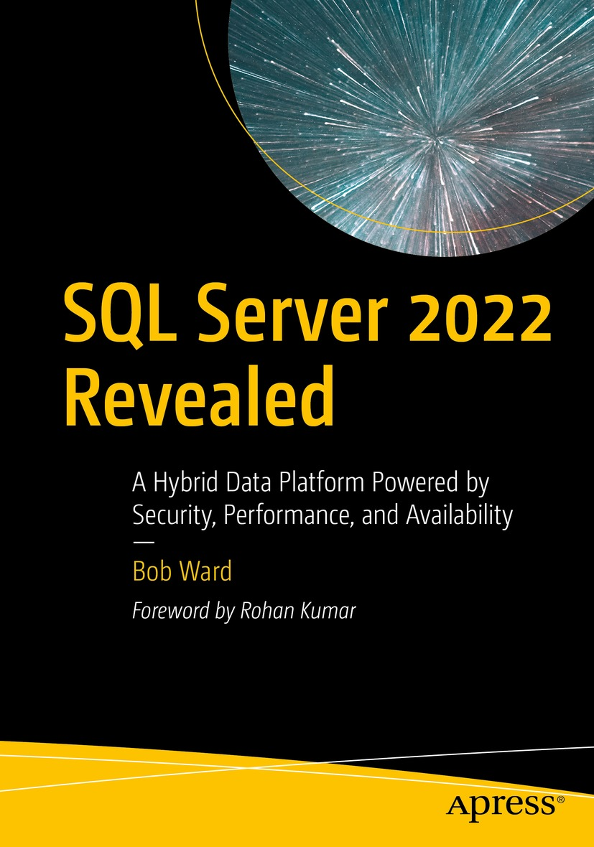

Learn more
https://aka.ms/sqlserver2022decks
https://aka.ms/bobsqldemos
Learn more about SQL Server 2022
aka.ms/sqlserver2022
Try our demos
aka.ms/sqlserver2022demos
Download SQL Server 2022
aka.ms/getsqlserver2022
Watch Microsoft Mechanics
aka.ms/sqlserver2022mechanics
Get our decks
aka.ms/sqlserver2022decks
Don’t miss us on Data Exposed
aka.ms/sqlserver2022series
What’s new for SQL Server 2022
aka.ms/sqlserver2022docs
Read the SQL Server 2022 Blog Series
aka.ms/sqlserver2022blogs
Read the book
aka.ms/sql2022book
Take the Microsoft Learning Path
aka.ms/learnsqlserver2022
Try out the workshop
aka.ms/sql2022workshop

Slide 18

Session feedback
https://sqlb.it/?12742

